Slide 1
Entwicklung einer Digital Twin-Applikation für einen Industrieroboter mit ROS und OPC-UA
Ahmed Ibrahim Almohamed
ibraah0@thu.de

Slide 2
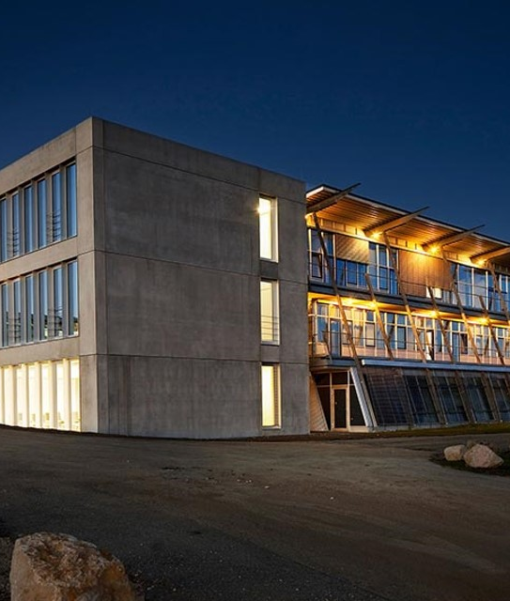
Agenda
Introduction
Technical Foundations
Use case Application
System overview
State of the art
Conclusion

Slide 3
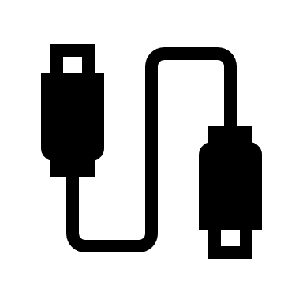
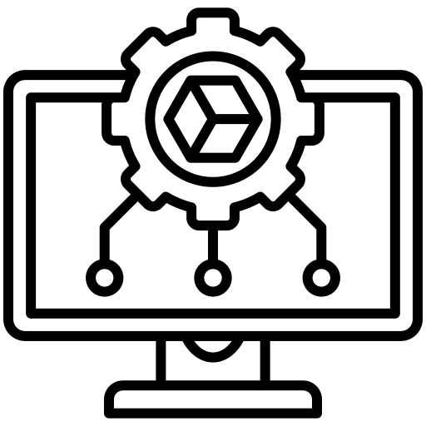
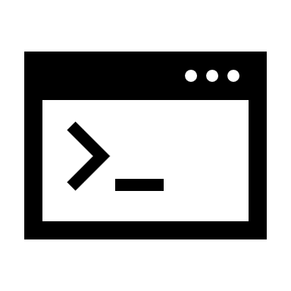
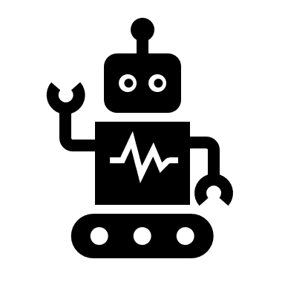
Introduction
Problem
Manual coding to the robot
No simulation environment
Limited Software Skills
Shrink the focus on the robotics concept
Notes:
Many students have limited software development skills, making it difficult to navigate the complexities of coding and robot interaction.
Students manually write code on their PCs and transfer it to the robot using a USB drive, which is time-consuming.
The manual process increases the likelihood of errors and requires significant technical effort, distracting students from focusing on core robotics concepts.
There is currently no simulation environment where students can test their code before deploying it on the real robot, limiting opportunities for trial and error

Slide 4
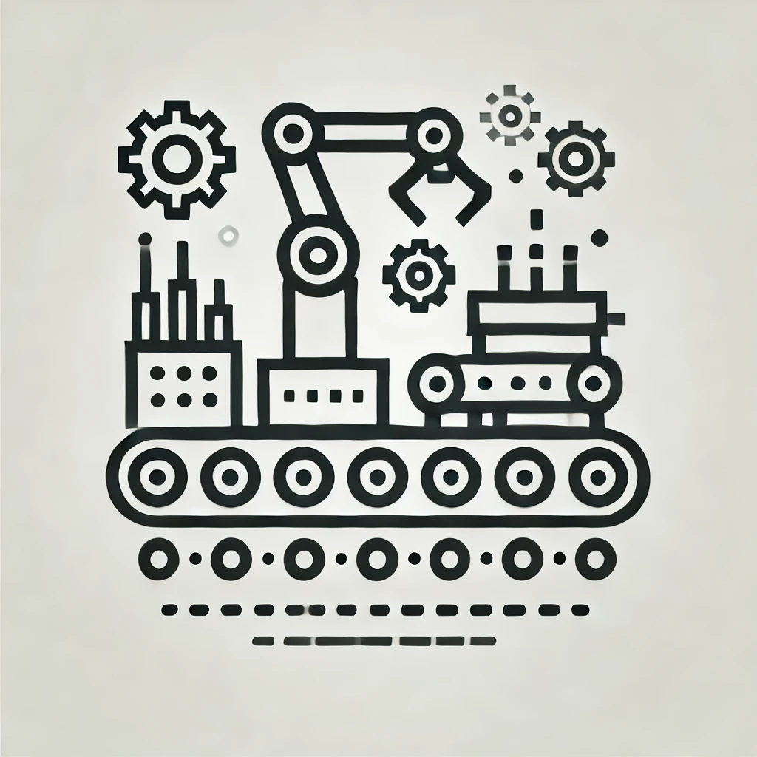
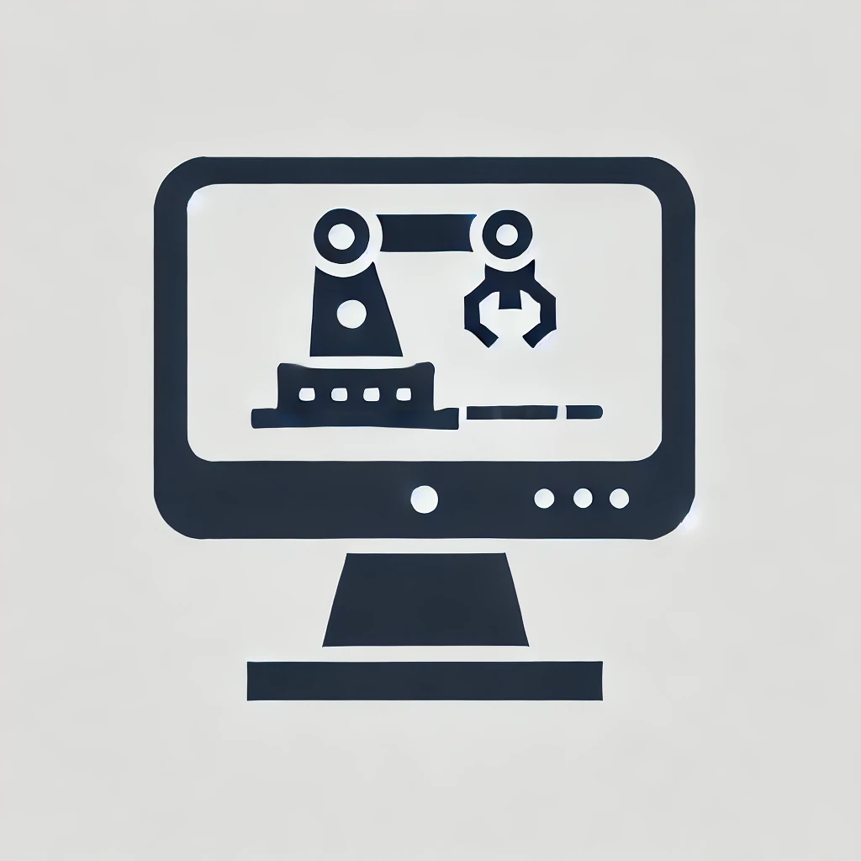
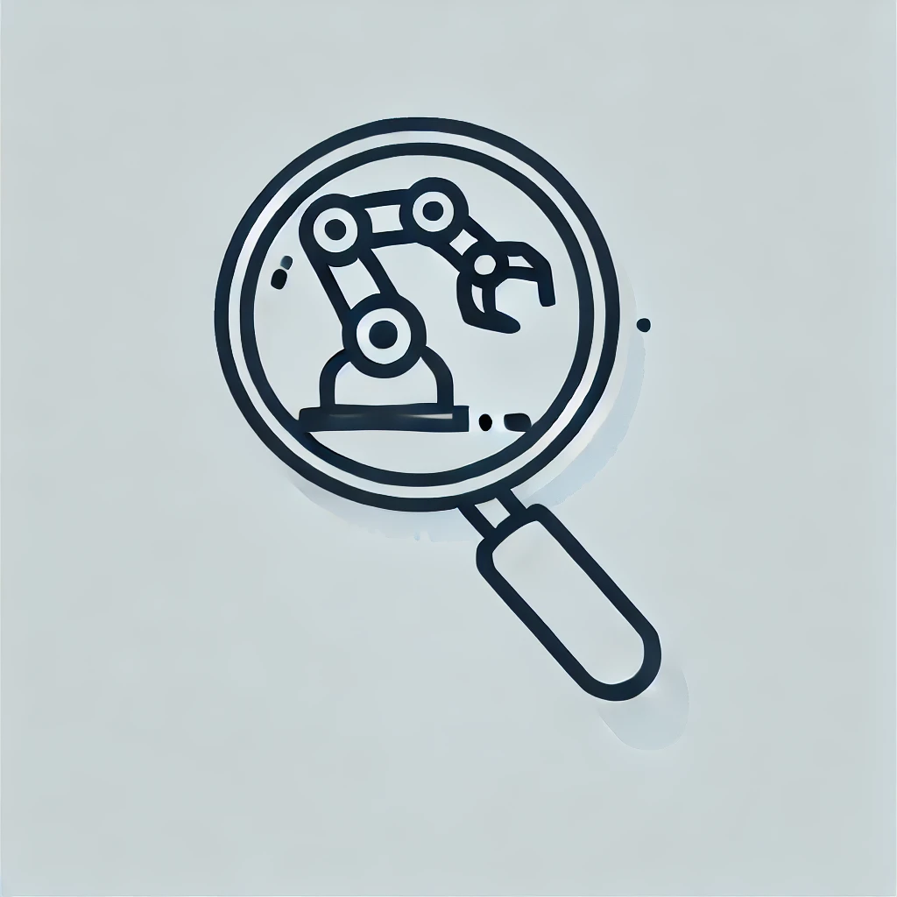
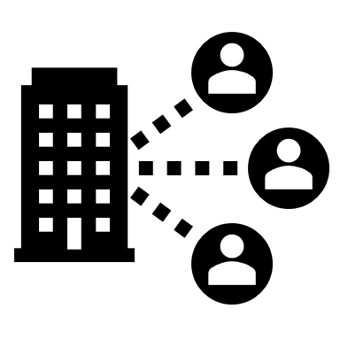
Introduction
Goals
Simulation and real time integration
Automation
Focus on Robotics concepts
Remote access
Notes:
Automation: Automate the process of transferring code to the robot and controlling it to reduce technical overhead.
Focus on Robotics Concepts: Enable students to concentrate on understanding robotics concepts rather than dealing with complex software development tasks.
Simulation and Real-time Integration: Provide a simulation environment where students can test their code before using the physical robot, or even run simulations and real robots in parallel, enhancing the learning experience.

Slide 5
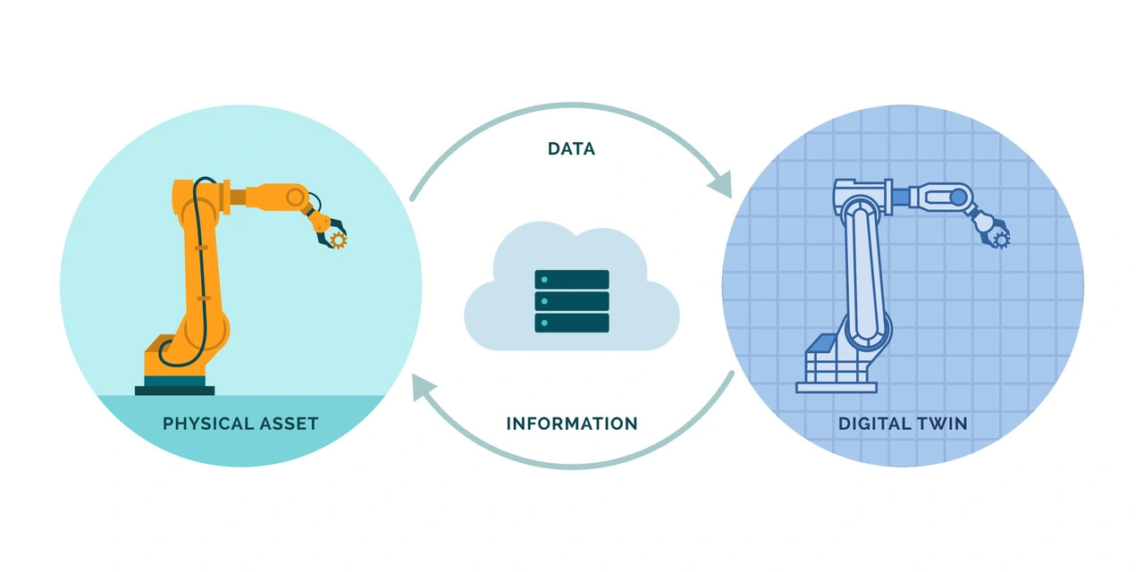
Technical Foundations
Digital Twin
Notes:
What is a DT ?
represents the creation of a virtual replica of a physical object or system that is used to simulate, monitor, and optimize its real-world counterpart.

Slide 6
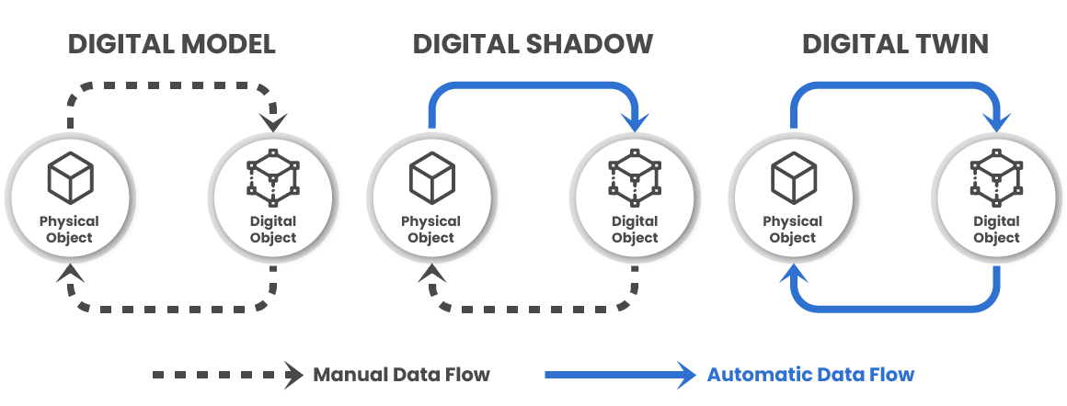
Technical Foundations
Level of Integration
Notes:
Layers of integration :
Mirroring or Digital Model : Digital representation of a physical entity
Digital Shadow : Physical to virtual uni-directional information flow
Digital Twin : virtual to physical bi-directional information flow

Slide 7
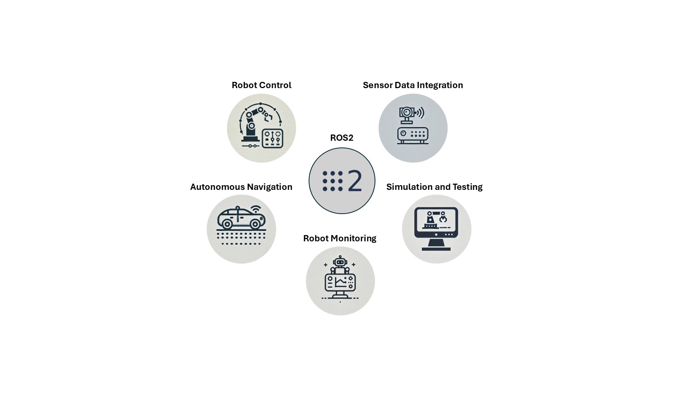
Technical Foundations
ROS2
Notes:
What is ROS2 :
is an open source software development kit for robotics applications
The Robot Operating System (ROS) is a set of software libraries and tools for building robot applications. From drivers and state-of-the-art algorithms to powerful developer tools,
The purpose of ROS 2 is to offer a standard software platform to developers across industries that will carry them from research and prototyping through to deployment and production

Slide 8
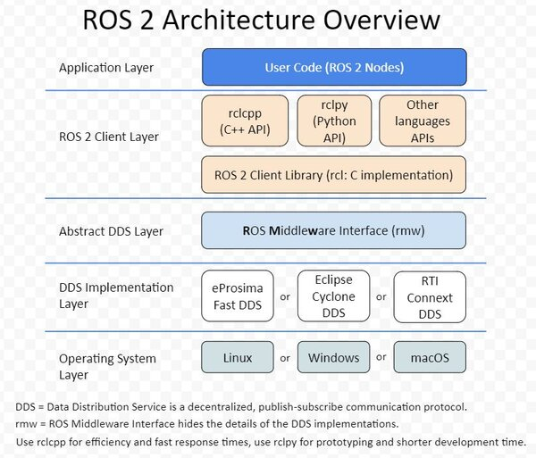
Technical Foundations
ROS2 software architecture
Notes:
OS Layer: ROS 2 runs on different operating systems (Linux, Windows, Mac).
ROS Middleware Layer (RMW): ROS 2 is based on the Data Distribution Service (DDS), an open standard for communications implemented over UDP. Since different DDS vendors can be used, a DDS API is provided, the ROS Middleware interface (rmw). The adoption of DDS allows the exchange of information between processes with real-time characteristics, security capabilities, and custom quality of service of each connection.
ROS client library (RCL): The basic functionality of all ROS 2 elements are implemented in a single C library called rcl; then the libraries rclcpp and rclpy adapt this functionality to the particularities of each language, C++ and Python, respectively. APIs for other languages can be implemented. This allows new functionalities to be available sooner in any language.
User Code: ROS 2 provides a convention on how to write nodes by forcing implemented nodes to inherit from a Node class that already has all the functionalities required. This saves a lot of time, facilitates a good modular structure and eases the cooperation between projects

Slide 9
Technical Foundations
ROS2 Nodes
Notes:
ROS2 Nodes :
A node is a participant in the ROS 2 graph, which uses a client library to communicate with other nodes. Nodes can communicate with other nodes within the same process, in a different process, or on a different machine. Nodes are typically the unit of computation in a ROS graph; each node should do one logical thing.
Nodes can publish to named topics to deliver data to other nodes, or subscribe to named topics to get data from other nodes. They can also act as a service client to have another node perform a computation on their behalf, or as a service server to provide functionality to other nodes.

Slide 10
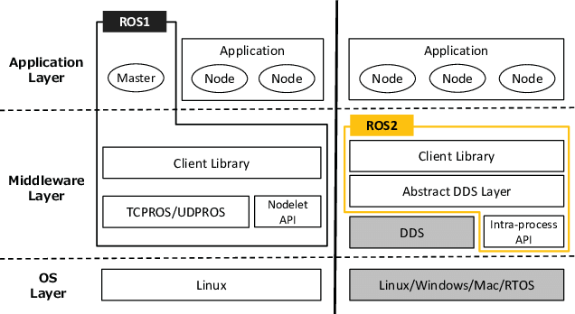
Technical Foundations
ROS2 and ROS
Notes:
The main differences related to communications (detailed in Section Communications in ROS 2) are:
The decentralized architecture (there is no ROS master; there are no global parameters) (In ROS 1 the ROS master acted as DNS server, i.e. it allowed nodes to retrieve info and communicate. In ROS 2 there is no master! By using the DDS communication middleware protocol, in ROS 2 each node has the capacity to discover any other node, which gives rise to fully distributed systems.)
As a difference with ROS 1, in ROS 2 services are asynchronous, i.e. the main thread is not stuck, although they can be made synchronous.

Slide 11
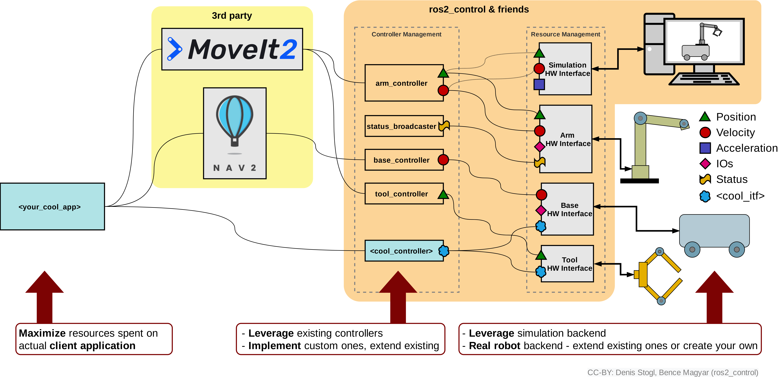
Technical Foundations
ROS2 Robotics Workflow
Notes:
ROS2 Layers :
App Layer : where the high level commands come ( RVIZ or some ros2 node )
3rd party software : like Movit2 for motion planning, manipulation, 3D perception, kinematics, control, and navigation.
Controllers

Slide 12
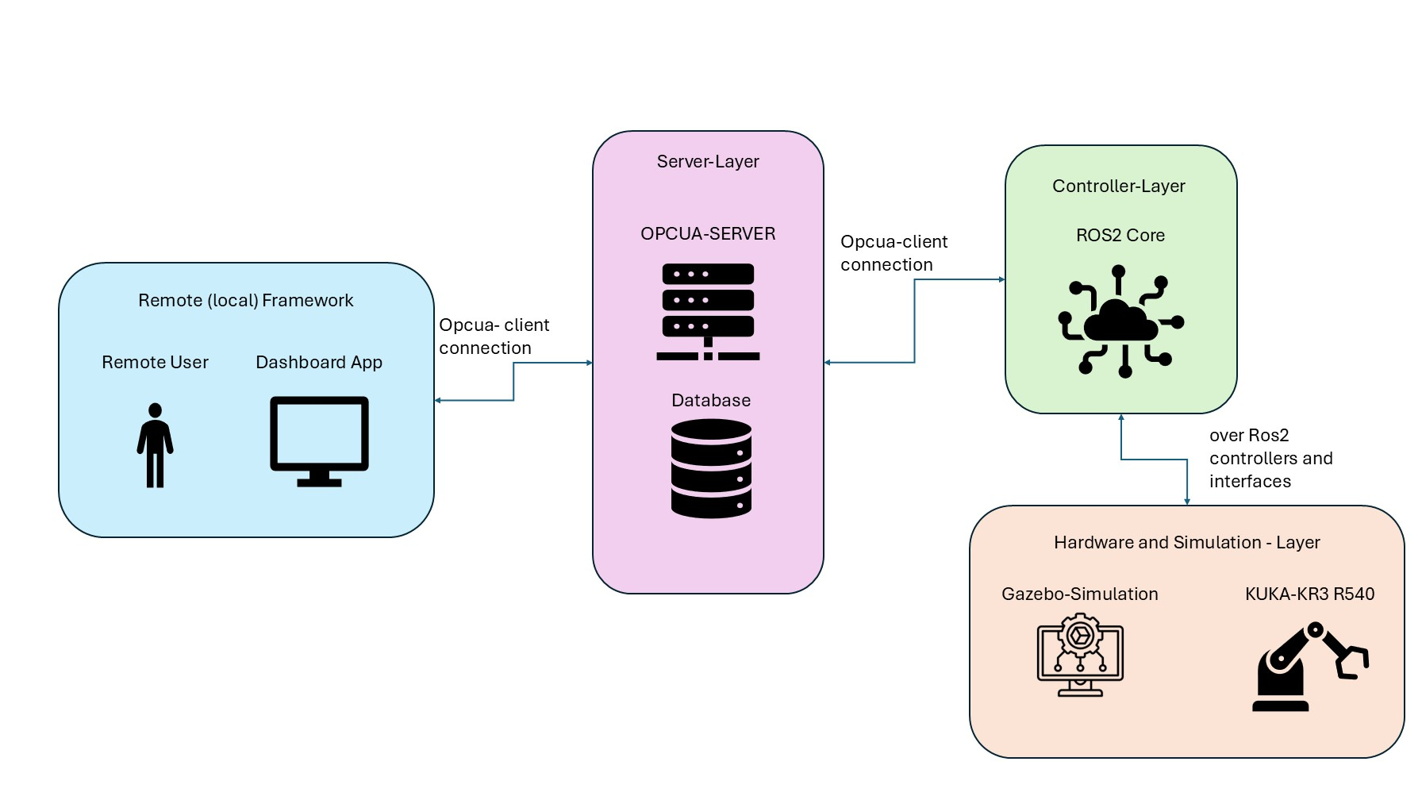
Use case Application
Remote (and local) Monitoring and Control of KUKA robots in the THU robotics lab
Notes:
Usecases overview :
Main components :
Remote frame work : is a dashboard with functionalities to chose the point to move both of the twins (and monitor the simulation)
Server Layer : connect the remote frame work with the controller layer of the system and authenticate the user (and store the user data and system data )
Controller layer : control the hardware layer accordingly to the user interactions and sends back states from the hardware to the user layer
Hardware and Simulation layer : contains the connections to the hardware and the simulation and their own system

Slide 13
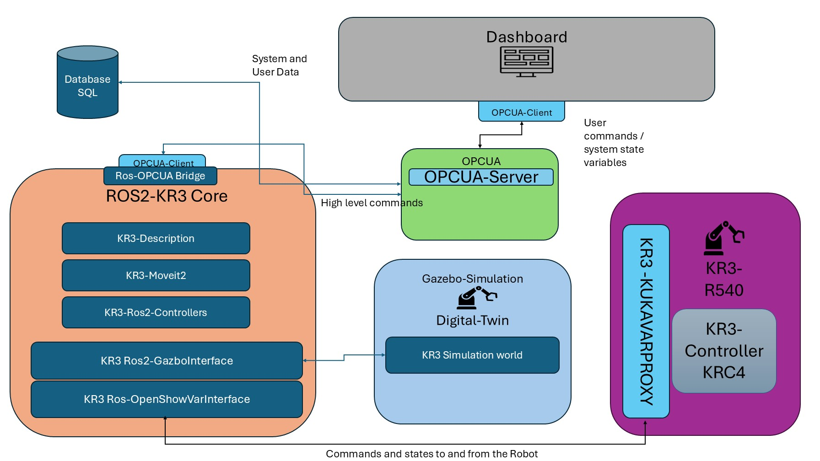
Use case Application
System Overview
Notes:
System overview :

Slide 14
Vielen Dank für Ihre Aufmerksamkeit.
www.thu.de

